Slide 1
Programming Fundamentals
By
Shazmeen Batool

Slide 2
Previous Lecture
Default Arguments
Function Overloading
Inline Functions

Slide 3
Today’s Lecture
Recursion

Slide 4
Recursion
A recursive function is one that calls itself.
You have seen instances of functions calling other functions. Function A can call function B, which can then call function C. It’s also possible for a function to call itself. A function that calls itself is a recursive function.

Slide 5
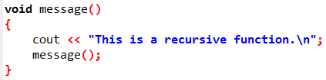
Recursion
This function displays the string “This is a recursive function.\n”, and then calls itself. Each time it calls itself, the cycle is repeated. Can you see a problem with the function?
There’s no way to stop the recursive calls. This function is like an infinite loop because there is no code to stop it from repeating.
The function example message will eventually cause the program to crash.

Slide 6
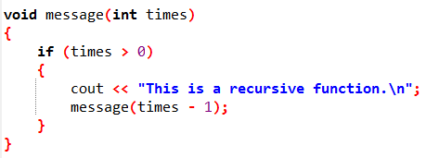
Recursion
Like a loop, a recursive function must have some method to control the number of times it repeats.

Slide 7
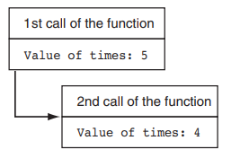
Recursion
For example, let’s say a program calls the function with the following statement:
The argument, 5, will cause the function to call itself five times.

Slide 8
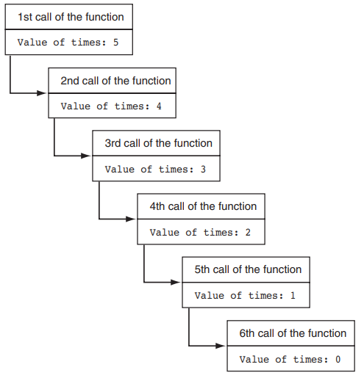
The function is called a total of six times.
The first time it is called from main, and the other five times it calls itself, so the depth of recursion is five.
When the function reaches its sixth call, the times parameter will be set to 0.
At that point, the if statement’s conditional expression will be false, so the function will return.

Slide 9
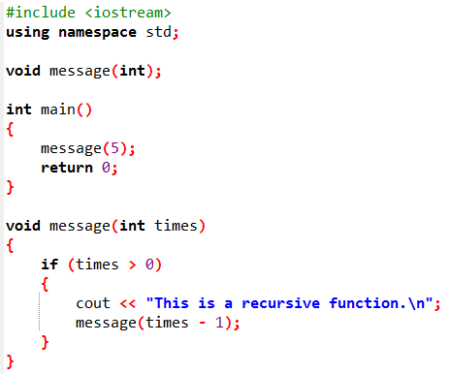
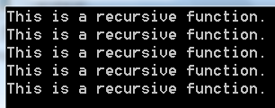
Example

Slide 10
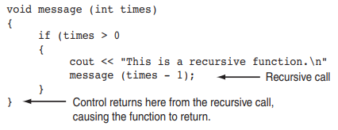
Recursion
Control of the program will return from the sixth instance of the function to the point in the fifth instance directly after the recursive function call:

Slide 11
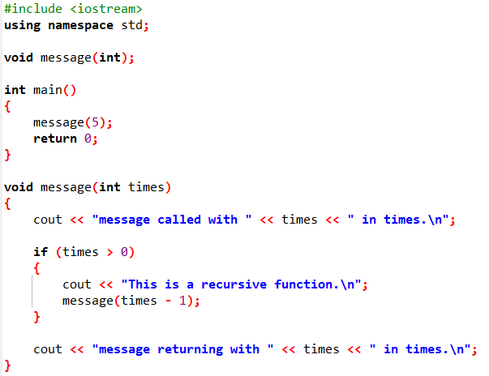
Example

Slide 12
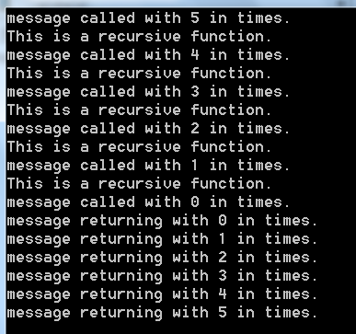
Output

Slide 13
Recursion
Some repetitive problems, however, are more easily solved with recursion than with iteration.
Where an iterative algorithm might result in faster execution time, the programmer might be able to design a recursive algorithm faster.
In general, a recursive function works like this:
If the problem can be solved now, without recursion, then the function solves it and returns.
If the problem cannot be solved now, then the function reduces it to a smaller but similar problem and calls itself to solve the smaller problem.

Slide 14
Recursion
In order to apply this approach, we first identify at least one case in which the problem can be solved without recursion. This is known as the base case.
Second, we determine a way to solve the problem in all other circumstances using recursion. This is called the recursive case.
In the recursive case, we must always reduce the problem to a smaller version of the original problem.
By reducing the problem with each recursive call, the base case will eventually be reached and the recursion will stop.

Slide 15
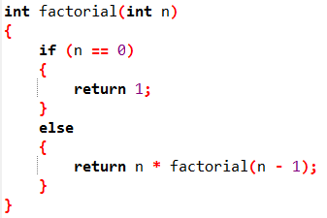
Recursion
The recursive function for computing factorial(n) can be simply described as follows:

Slide 16
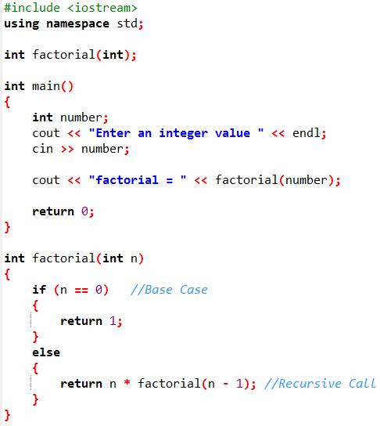

Example

Slide 17
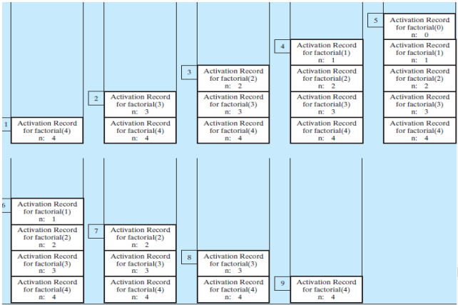
Activation Record

Slide 18
Recursion
Recursion is a technique that leads to elegant solutions to problems that are difficult to program using simple loops.
Recursion is a useful programming technique. In some cases, it enables you to develop a natural, straightforward, simple solution to an otherwise difficult problem.

Slide 19

Infinite Recursion
Infinite recursion can occur if recursion does not reduce the problem in a manner that allows it to eventually converge into the base case or a base case is not specified.
For example, suppose you mistakenly write the factorial function as follows:
The function runs infinitely and causes the stack overflow.

Slide 20
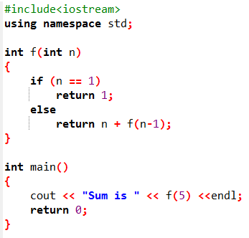

Activity: Show the output of the following program and identify base cases and recursive calls.

Slide 21
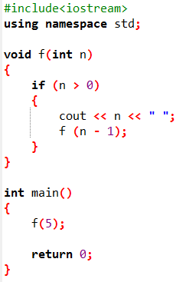
Activity: Show the output of the following program and identify base cases and recursive calls.

Slide 22
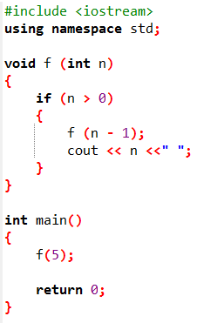

Activity: Show the output of the following program and identify base cases and recursive calls.

Slide 23
Next Lecture
Structure

